Slide 1
Container Security Best Practices on AWS
Alaa Saeed
Cork|Sec 116

Slide 2


About me
DevOps Engineer @
Ex-AWS Cloud Support Engineer (Deployment)
Likes:
Tech
Nature
Photography
Dislikes:
Raw onions
alaa.sh
@alsaedwy

Slide 3
AGENDA
01
AWS Container Scanning Tools
02
03
04
Basic VS Enhanced ECR Scanning
Utilizing AWS Services; EventBridge & Lambda
Takeaways/Best Practices
Questions
05

Slide 4
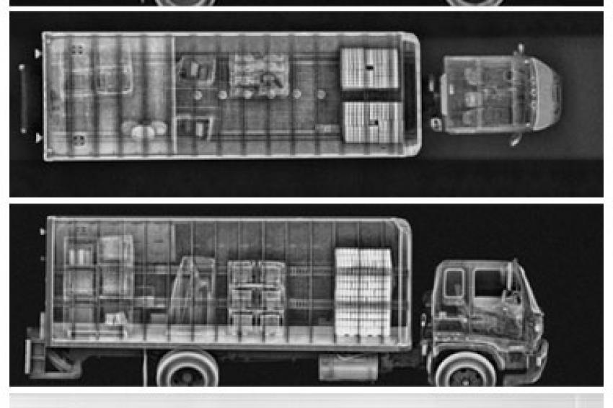
01 AWS Container Scanning Tools

Slide 5
Container Scanning
Each container consists of layers.
Each layer is inspected for known vulnerabilities, usually from the Common Vulnerabilities and Exposures (CVE) database.
Well-known tools for scanning:
AWS ECR – Basic & Enhanced (Inspector) Scanning
Clair
Trivy
Snyk – Used by Docker Scan
Qualys
More!

Slide 6
Container Scanning
Some scanning tools has more features:
Scanning Application Dependencies
Checks vulnerabilities in dependency files (Gemfile.lock, package-lock.json, Pipfile.lock, etc)
Misconfiguration Detection
Scans IaC files for misconfiguration & custom-made policies

Slide 7
AWS Tools - Amazon ECR Basic Scanning - Amazon ECR Enhanced Scanning

Slide 8
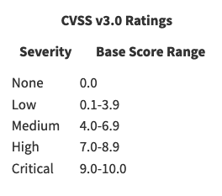
Amazon ECR – Basic Scanning
Uses Clair in the background to query the CVEs database.
Severity is determined from the upstream distribution source –if available-.
Common Vulnerability Scoring System (CVSS) is used otherwise.

Slide 9
Amazon ECR – Basic Scanning
Can be configured to ‘Scan on Push’, or manually for each image.
Each image (with unique digest and tag) can be scanned after 24 hours of the initial scan.
Scan findings are accessible using either the console, AWS CLI or the API Call DescribeImageScanFindings.

Slide 10
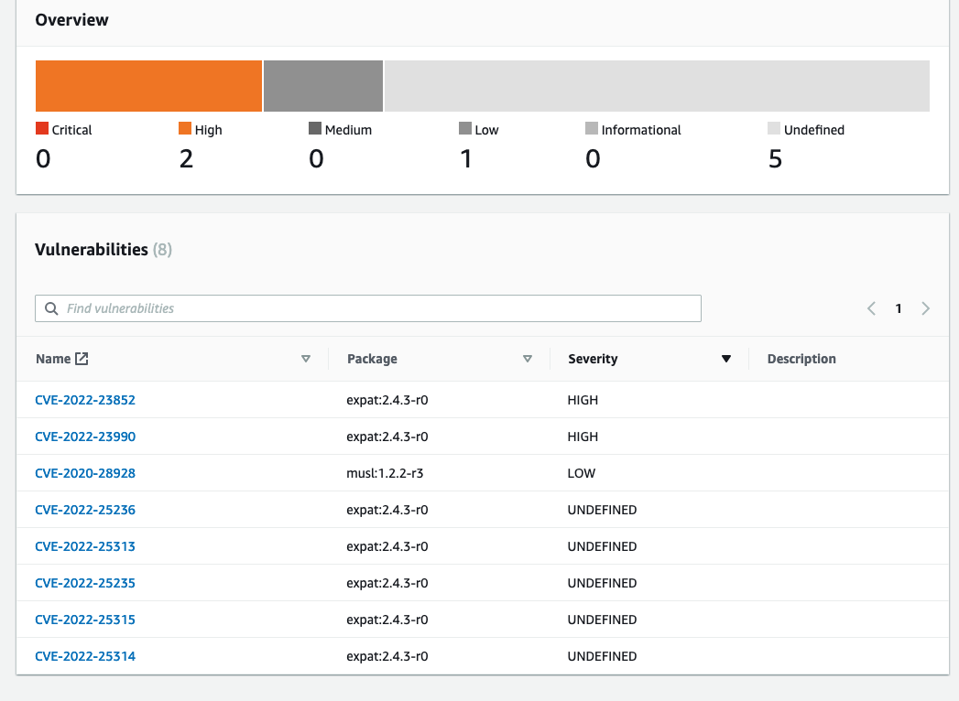
Amazon ECR – Basic Scanning

Slide 11
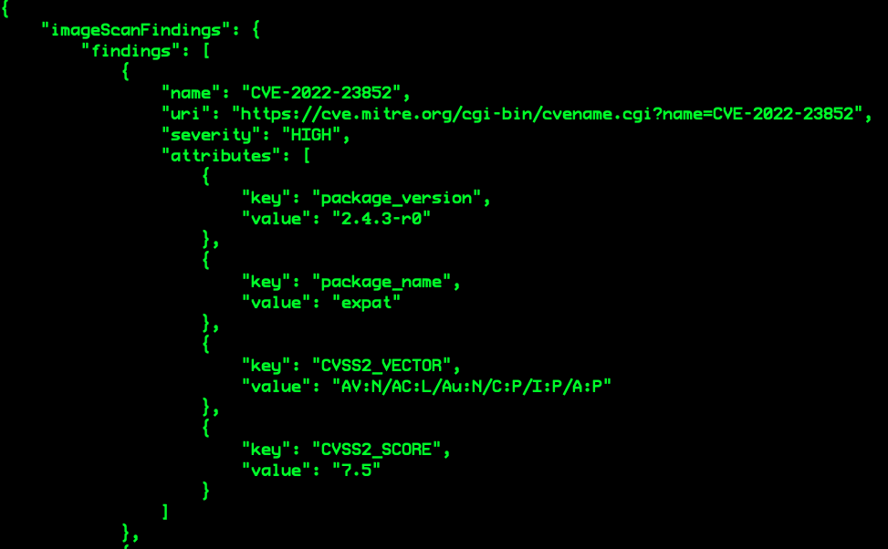
Amazon ECR – Basic Scanning

Slide 12
Amazon ECR – Enhanced Scanning

Slide 13
Amazon ECR – Enhanced Scanning
Integrates ECR with Amazon Inspector for vulnerability scanning.
Currently has a diverse list for supported operating systems and programming languages.
Does –not- support manual scanning.
Supports Scan on Push or Continuous Scanning.
Continuous Scanning works as long as the image is updated within 30 days.

Slide 14
Amazon ECR Enhanced Scanning (Inspector)

Slide 15
Amazon Inspector
Automated vulnerability management service that continually scans AWS workloads for software vulnerabilities and unintended network exposure.

Slide 16
Amazon Inspector
Features and use cases:
Quickly discover vulnerabilities (Continuous Scanning)
Prioritize patch remediation (Scoring)
Identify zero-day vulnerabilities sooner (Using diverse sources for vulnerability intelligence).

Slide 17
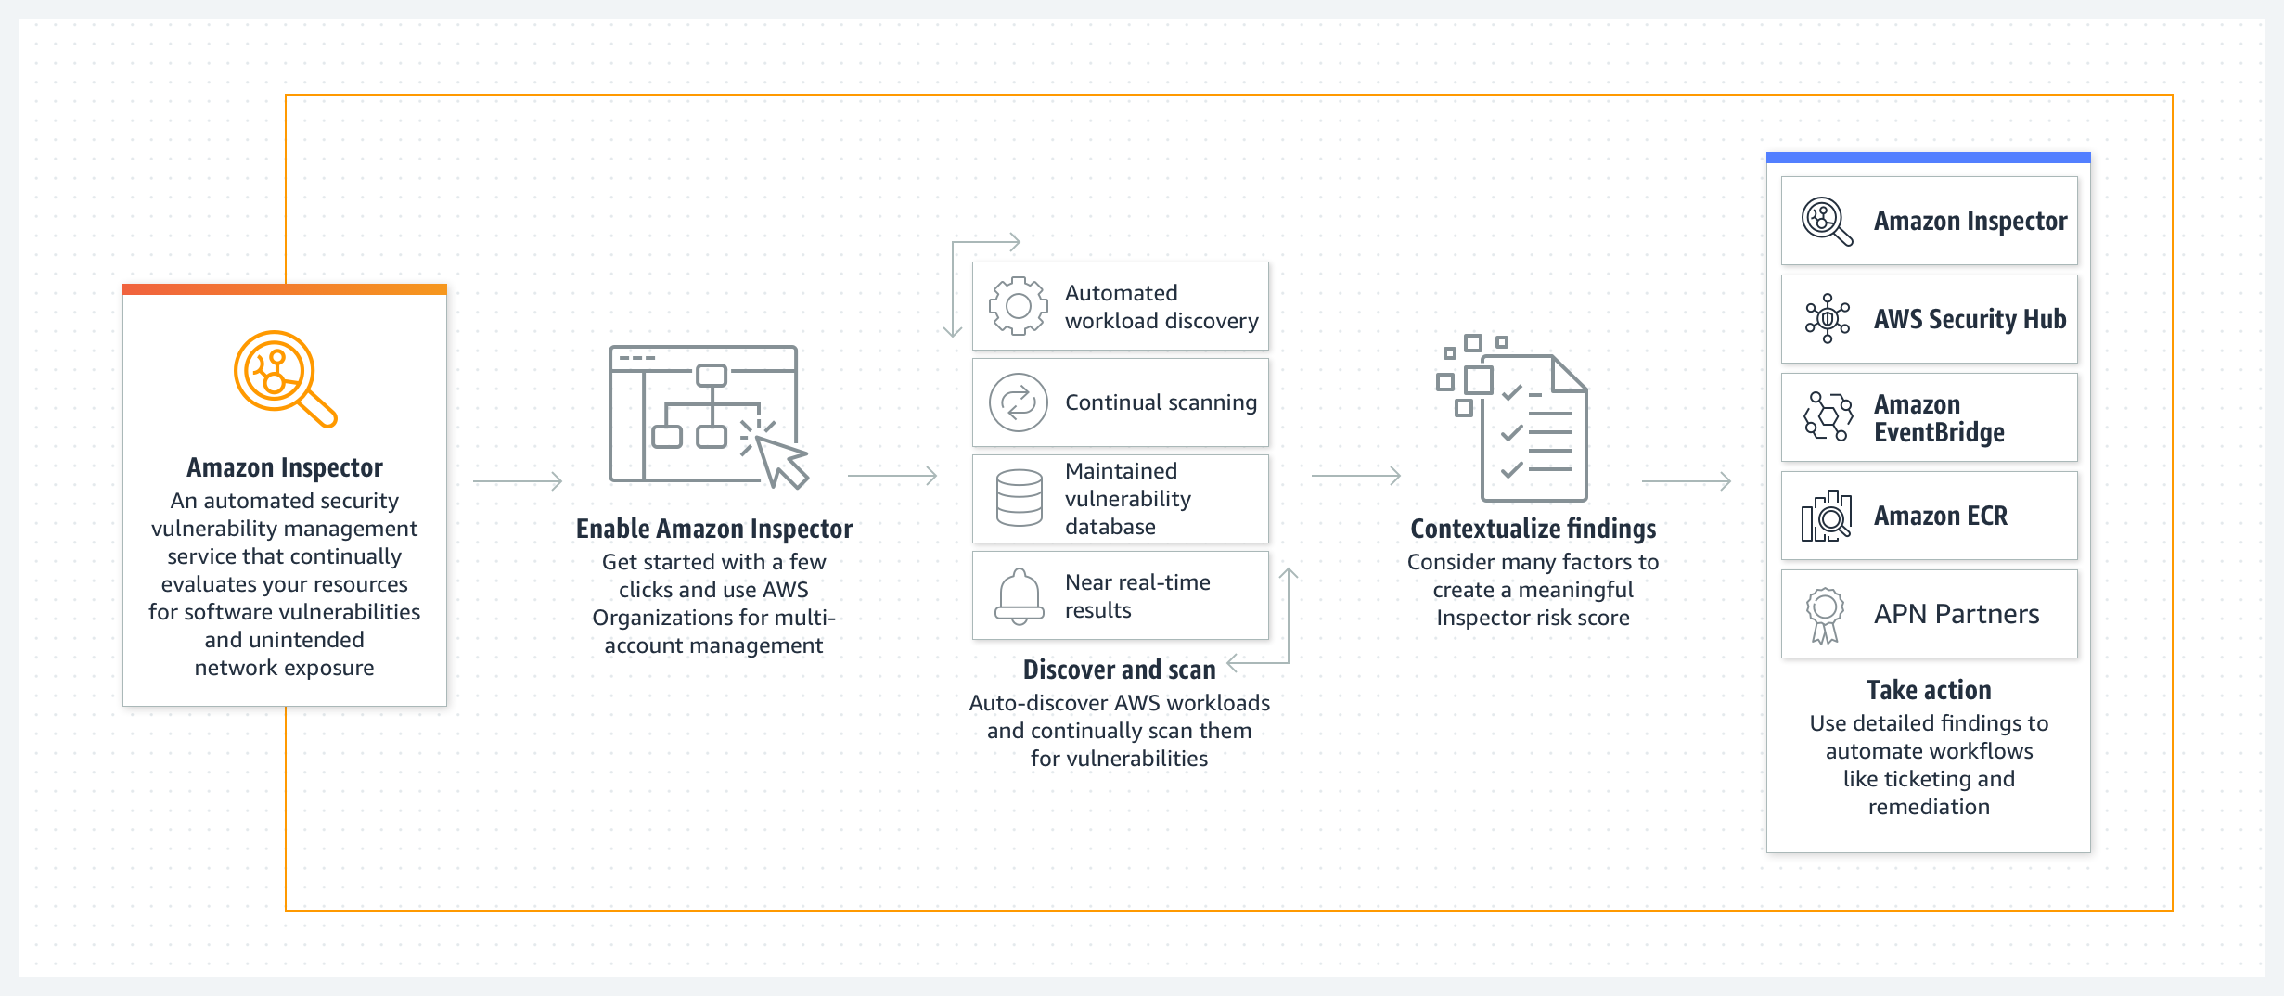
Amazon Inspector

Slide 18
02 - Differences between Basic and Enhanced Scanning

Slide 19
Differences
 | Basic | Enhanced
Scanner | Clair | Amazon Inspector
Scanning Methods | Manual, Scan on Push | Scan on Push, Continuous
Event Source (Completion) | ECR | Amazon Inspector (inspector2)
Findings | ECR (Console, CLI, API) | ECR, Amazon Inspector
Vulnerability Database | CVEs through Clair | Different various sources
Risk Score | Common Vulnerability Scoring System (CVSS) | Amazon Inspector Proprietary Calculator

Slide 20
03 - Utilizing AWS Services; EventBridge & Lambda

Slide 21
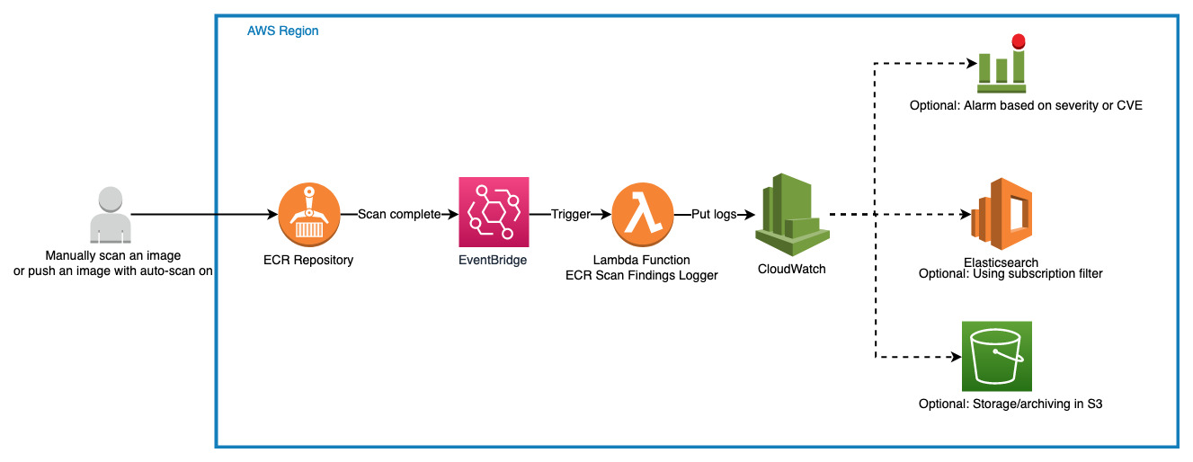

Slide 22
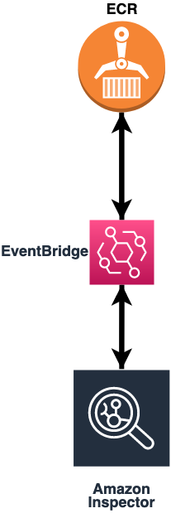
Utilizing AWS Scanning Tools
When enhanced scanning is enabled:
1- Amazon ECR sends an event to EventBridge when the scan frequency for a repository is changed.
2- Amazon Inspector emits events to EventBridge when an initial scan is completed and when an image scan finding is created, updated, or closed.

Slide 23
Demo: Logging ECR Scan Findings into CloudWatch

Slide 24
04 – Takeaways/Best Practices

Slide 25
Always use a container scanner, preferably one that can detect zero-day vulnerabilities
Keep your containers up-to-date
Patch containers if possible (custom builds)
Enable an alarm for CRITICAL vulnerabilities

Slide 26

Questions

Slide 27
Thanks!

